Slide 1

Composing a Legacy

Slide 2
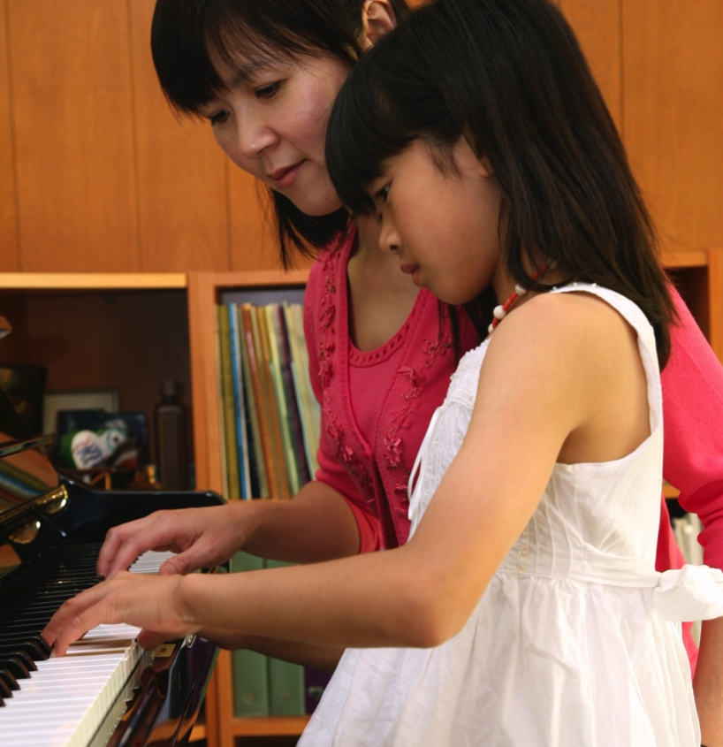
Why Legacy Planning?
Clarify family vision
Prepare for future goals
Provide for spouse and dependents
Provide for philanthropic goals now and later

Slide 3
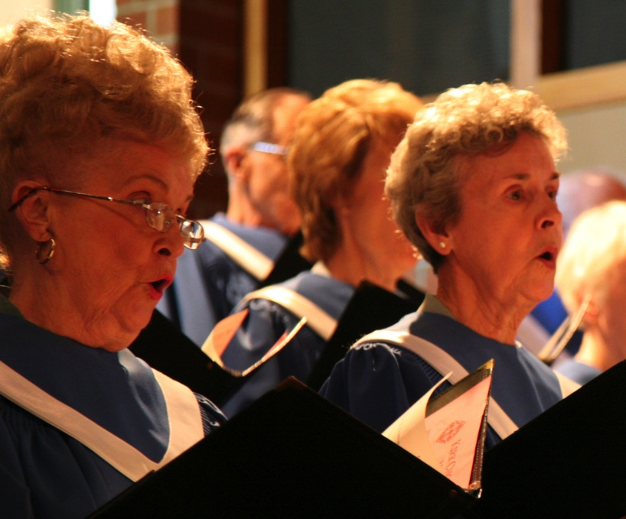
Components of Your Legacy Plan
Will
Durable power of attorney
Living will directive/healthcare proxy
Trusts
Tax reduction plans
Guardian for dependents
Business succession
Charitable bequests
Life income plan

Slide 4

Wills Meet a Variety of Needs
Writing your will is one of the most important steps you can take to plan your estate.

Slide 5
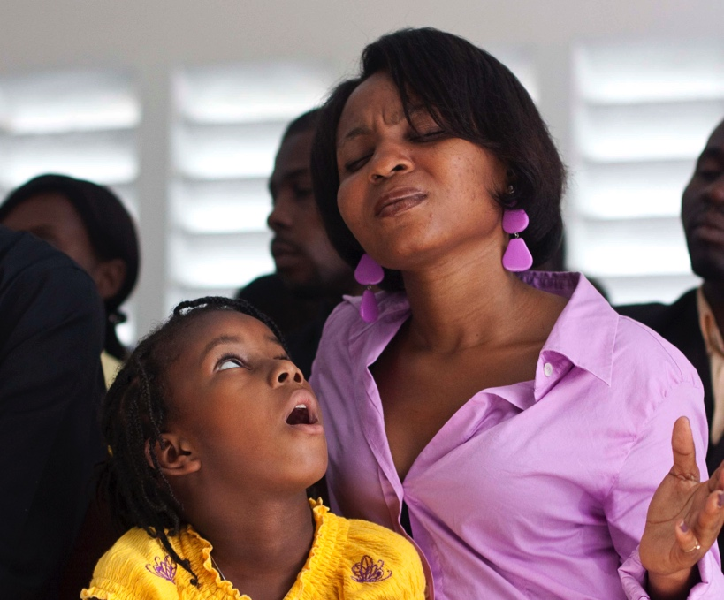
Where Does Your Faith Appear?
Have you spoken of God’s grace and love as the source of your faith?
Have you considered your life and family values, including the Church and its mission?
Resource: Composing a Legacy

Slide 6
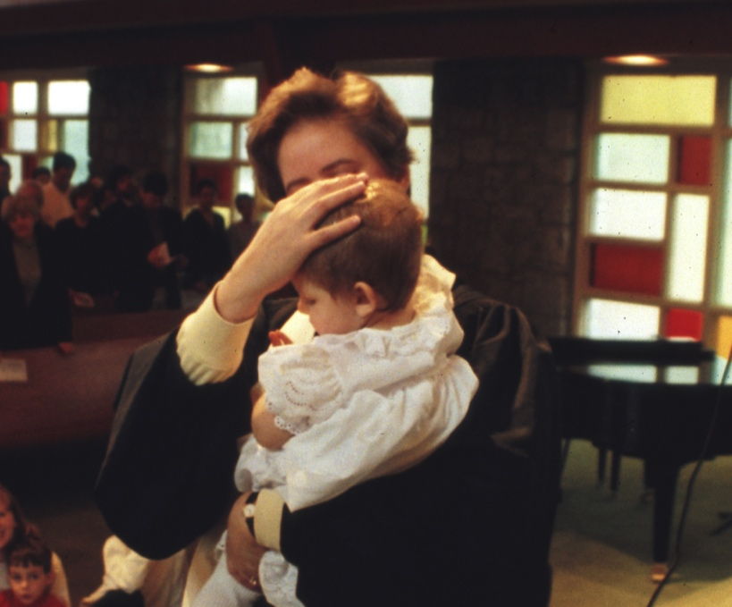
Charitable Estate Planning
Enduring statement of faith
Wise stewardship of assets
Provision for loved ones
Support for mission and ministry
Management of accumulated assets

Slide 7

When to Review Your Will?
Birth or adoption of children
Children have grown or married
Loss of spouse or loved one
Divorce or marriage
Move to another state
Change in financial situation
  Retirement
  Received inheritance
  Purchased vacation home

Slide 8

Considerations in Drafting Your Will
Inventory your assets
Identify beneficiaries (people and organizations)
Explore various charitable giving options
Resources: Estate Planning Workbook

Slide 9

The Charitable Component
Opportunities to make gifts now and in the future that will benefit causes important to you.

Slide 10
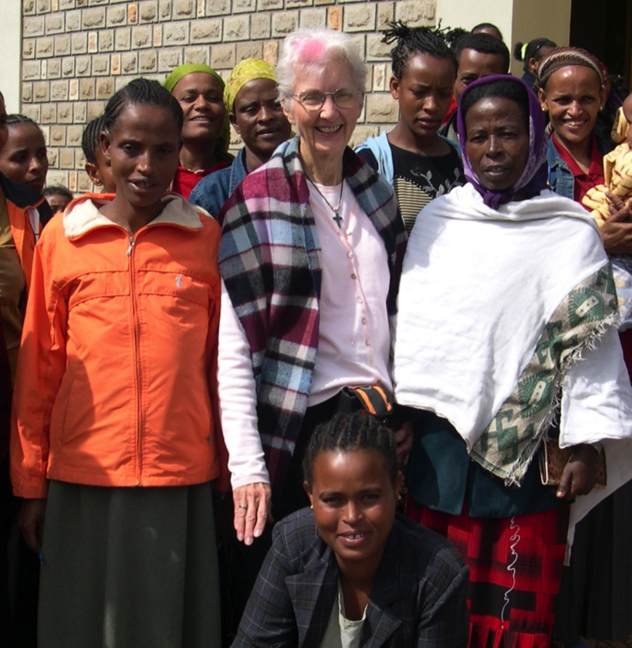
Planning a Bequest
Gift Amount
Stated amount
Percentage of estate
Residual amount
Purpose
Restricted
Unrestricted
Structure of Gift
Direct bequest, memorial or endowment fund, charitable life income plan

Slide 11

Assets to Consider
Life Insurance, Retirement Plans, Real Estate,
and Nontraditional Assets

Slide 12

Life Insurance
Name church or charity as primary, secondary, or contingent beneficiary
Transfer ownership to church or charity
Purchase new policy as a charitable gift

Slide 13
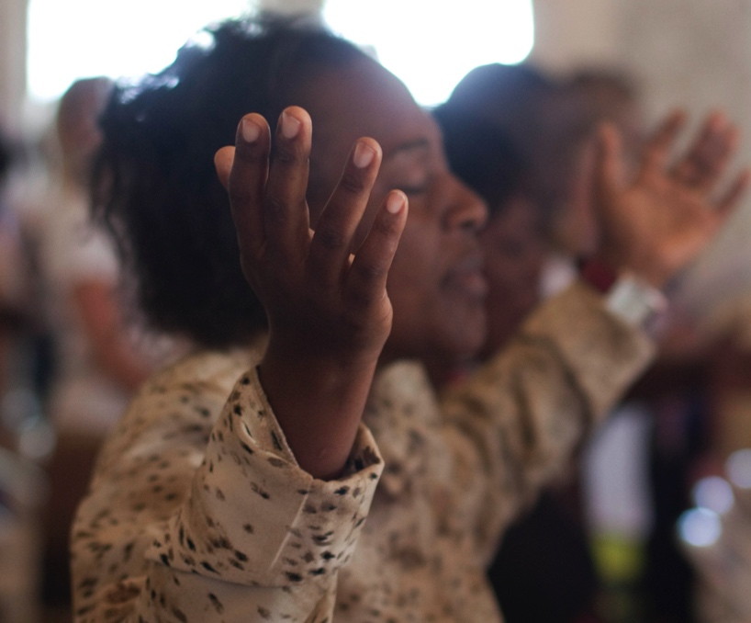
Retirement Plans
IRAs, 401(k)/403(b), Keogh
Accounts are included as part of estate
Heirs subject to federal income tax
Options:
  Designate church or charity as beneficiary
  Name charitable trust as beneficiary to provide lifetime income to person you select

Slide 14

Real Estate
Give highly appreciated, low basis property
  Charitable income tax deduction
  Avoid capital gains taxes
Give home or farm and retain use during lifetime
Name charitable trust owner to provide lifetime income to you or others, and to support church with remainder

Slide 15
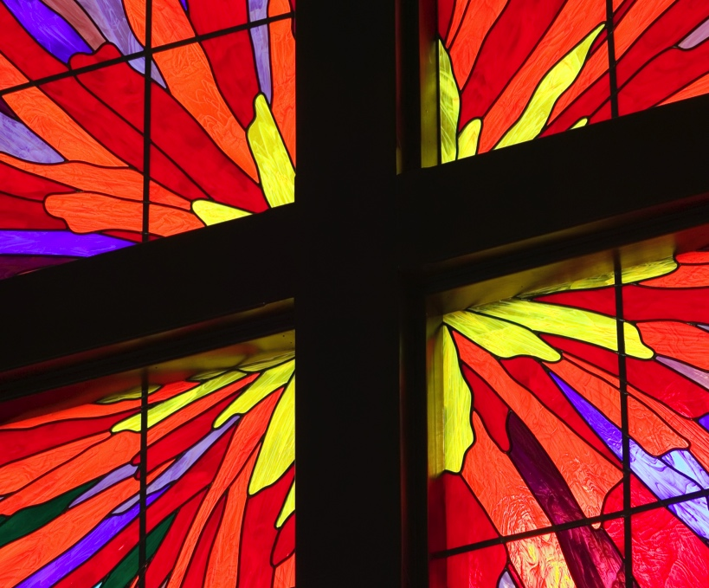
Other Nontraditional Assets
Art collection
Coin collection
Business interest

Slide 16

Giving Instruments to Consider
Endowment Fund, Donor-Advised Fund, Charitable Remainder Trust, and Charitable Lead Trust

Slide 17
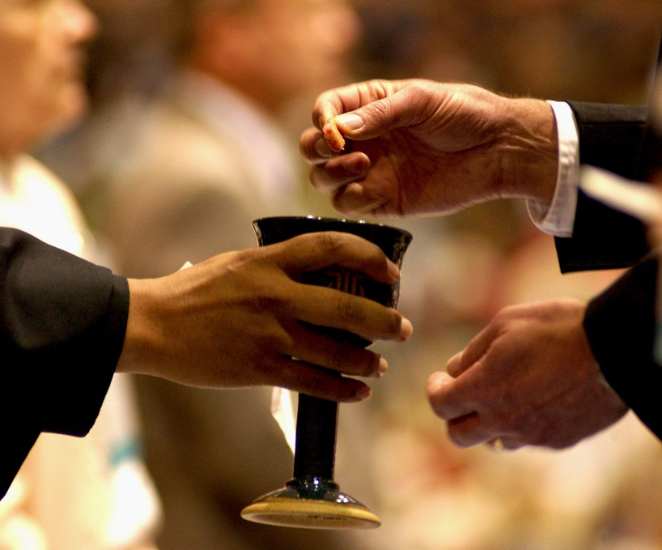
Endowment Fund
May be established as a memorial fund
Foundation invests the fund and income is distributed to charitable beneficiary in perpetuity
Provides continuous financial support
Minimum Gift — $25,000

Slide 18

Donor-Advised Fund
Flexibility to support the missions and ministries of the PC(USA) and beyond
You decide the amount of the grant and the timing
Include family members in the grant-making process, share your values
Avoid cumbersome responsibilities and costs of a private foundation
Minimum Gift — $2,500

Slide 19
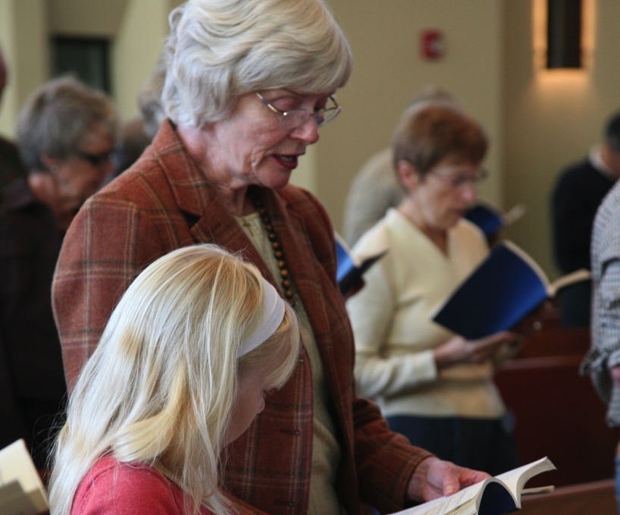
Charitable Remainder Trust
Income for you or survivors
Support mission after income is provided
Avoid realizing capital gain
Immediate income tax deduction
Estate tax reduction
*Trust services provided by New Covenant Trust Company, N.A., a subsidiary of the Presbyterian Foundation.

Slide 20

Charitable Lead Trust
Donor establishes and funds irrevocable trust
Charitable beneficiary receives payments first — usually for set term of years
At end of term, assets are returned to donor or passed to heirs
Passes assets to heirs at greatly reduced estate tax cost, while fulfilling stewardship goal
*Trust services provided by New Covenant Trust Company, N.A., a subsidiary of the Presbyterian Foundation.

Slide 21
Federal Estate Tax Rates & Exemption Amounts
Year | Estate & Gift Tax Exemption Amount | GST | Highest Estate Gift & GST Tax Rate
2015 | $5.43 million | $5.43 million | 40%
2016 | $5.43 million | $5.43 million | 40%
2017 | $5.49 million | $5.49 million | 40%
2018 | $11.18 million | $11.18 million | 40%
2019 | $11.4 million | $11.4 million | 40%
2020 | $11.58 million | $11.58 million | 40%
2021 | $11.7 million | $11.7 million | 40%
October 2021

Slide 22

Presbyterian Foundation
A vital part of the Presbyterian Church (U.S.A.), the Foundation cultivates, attracts, and manages financial resources of individuals and institutions to serve Christ’s mission.
Established in 1799.

Slide 23
The Rev. Ellie Johns-Kelley
Ministry Relations Officer
412-694-3226 Toll-free: 855-251-8212
ellie.johns-kelley@presbyterianfoundation.org

